Slide 1
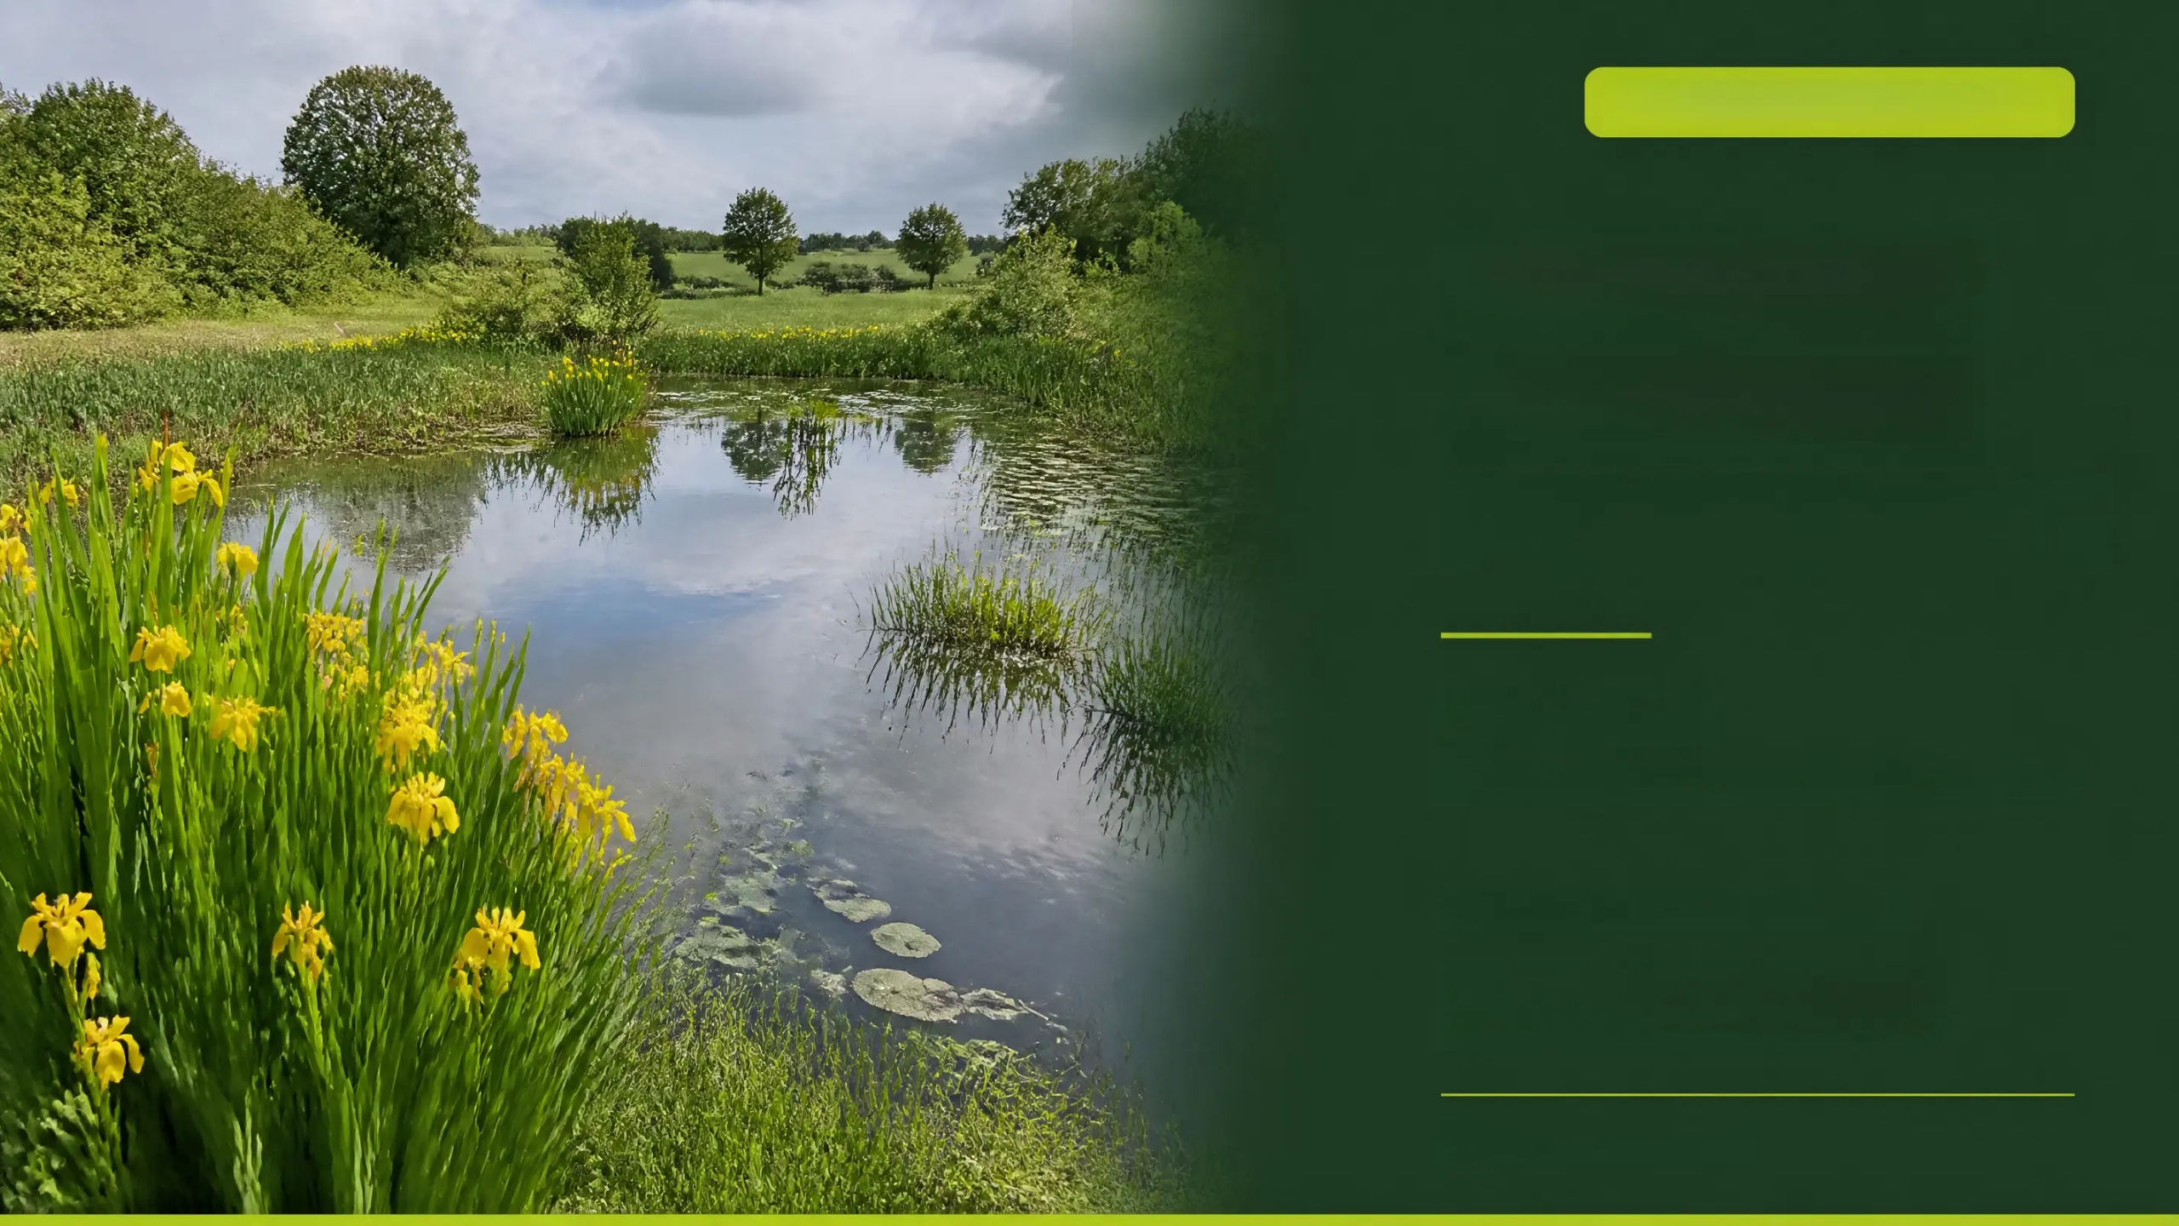
FARMING FOR WATER EIP
Build a
Small Scale
Wetland Pond
Measure 18 —
Construction & Compliance Guide
Farming for Water EIP Programme
LAWPRO | Teagasc | Dairy Industry Ireland |
Meat Industry Ireland | Dept. Agriculture
farmingforwater.ie

Slide 2


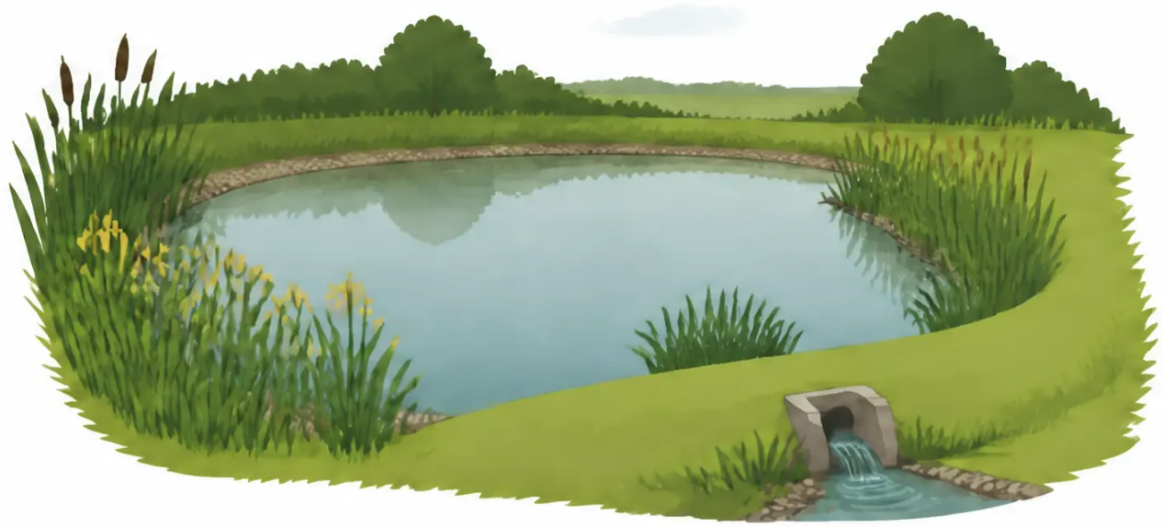







MEASURE 18 OVERVIEW
Understanding Measure 18
Capture nutrients and sediment before
they reach our waterways.
● Intercepts surface runoff carrying phosphorus and nitrogen
from farmland
● Creates natural habitat for birds, amphibians, insects
and wetland plants
● No planning permission required – no discharge licence needed
● Silt trap at inlet must account for ≥20% of total pond area –
the critical zone for nutrient and sediment removal
Not for: slurry, silage effluent, dairy washings,
or soiled water
Construction guidance: Georgina Mooney, UCD School of Biology & Environmental Science /
Farming for Water EIP (2026)
sizing: 10 m × 6 m × 0.5 m depth
€800
0.2 ha
1–3
per unit
maximum pond area
units per holding
No planning permission
Standard EIP rate
BISS eligibility maintained
Up to €2,400 total
No discharge licence required
farmingforwater.ie

Slide 3


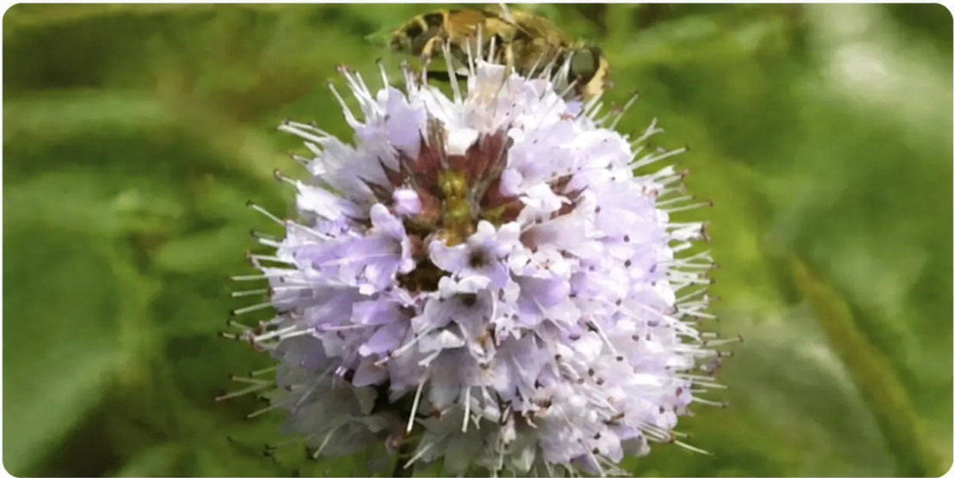
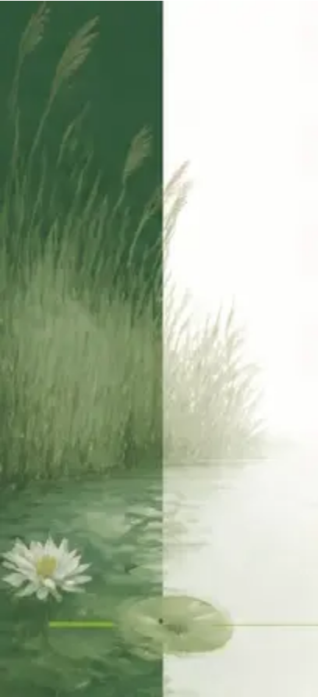
HOW IT WORKS
The Science of Wetland Ponds
Water Quality Mechanism
Biodiversity Co-Benefits
Runoff flows into shallow silt trap
(≥20% of pond area, 20-30cm deep)
at inlet
Emergent plants in silt trap slow
velocity and trap sediment-bound
phosphorus
Sediment-bound phosphorus is
trapped and retained
Microbial activity denitrifies nitrogen
at the oxygen-poor base
Water Mint — attracts bumblebees & butterflies
Emergent plant roots absorb nutrients
from the water column
Amphibians — frogs and smooth newts colonise within 1–2 years
Clean, filtered water exits via
the raised outlet notch
Insects — dragonflies and damselflies arrive by Year 1
Wetland Birds — snipe, heron, grey wagtail, kingfisher
Counts as a Nature-Based Solution (NbS)
under EU Climate Adaptation Strategy
Invertebrates — support wider farmland biodiversity
Pond creation guidelines: Georgina Mooney, UCD / Farming for Water EIP (2026). A single pond can support dozens of species within its first two seasons.

Slide 4










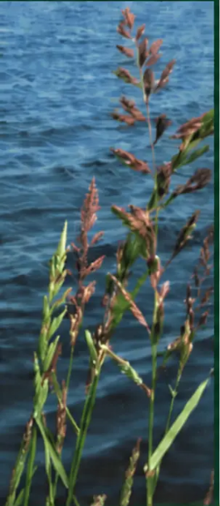









SLIDE 04 / SITE SELECTION
MEASURE 18 — CONSTRUCTION GUIDE
Site Selection Criteria
Choose the right location — your pond's performance depends on it.
IDEAL SITES
SITES TO AVOID
Impermeable Soils
Existing Ecological Features
Heavy clay or gley soils that hold water
naturally without lining
Hedgerows, rush pasture, wet grassland,
or scrub must not be disturbed
Natural Low Point — topographic depression
Active Floodplains
where runoff concentrates. Ideally site within
10-20m of an existing wet area or drain —
allows rapid plant colonisation of the new pond.
Will disrupt hydrology and the pond
won't function as designed
Along Flow Pathways
Sandy or Free-Draining Soils
In-line with overland flow from intensively
managed fields
Water won't be retained; consider a
willow filter bed instead
Near Drainage Infrastructure
Natura 2000 Proximity
Adjacent to field drains or open channels
SAC, SPA, NHA sites — assess hydrological
connectivity before proceeding
Accessible for Maintenance
Machine or foot access without crossing
sensitive ground
Near Private Wells
Two-Stage Construction — consider partial
installation in Year 1, observe flow paths over
summer/winter, then complete digging in Year 2
for best results.
Do not site upslope of drinking water
sources or private wells
Clay / Gley
Loam
Sandy Loam
Peat / Peaty Mineral
SOIL
SUITABILITY
Proceed — holds water
naturally
May need clay lining
Lining required or
use alternative
Check existing habitat
value first
EXCELLENT
GOOD
POOR
MODERATE

Slide 5



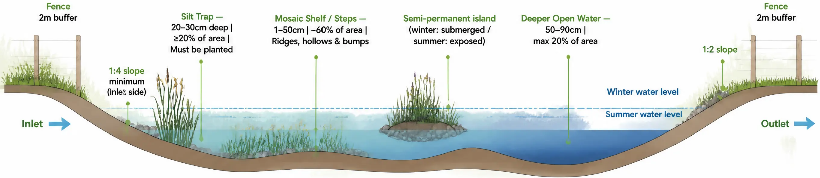






MEASURE 18 — TECHNICAL SPECS
Design and Dimensions
Pond zones per Georgina Mooney / O’Rourke & Loughran (2024)
POND ZONE SUMMARY TABLE
Zone
Depth
Area
Location
Silt Trap
20–30 cm
≥ 20%
At inlet — must be planted
Mosaic Shelf / Steps
1–50 cm
~ 60%
Throughout — ridges & bumps
Deeper Open Water
50–90 cm
≤ 20%
Throughout — limited
farmingforwater.ie
Source: Georgina Mooney, UCD / Farming for Water EIP (2026)

Slide 6










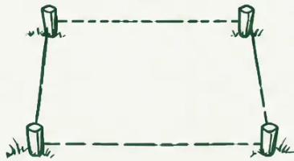
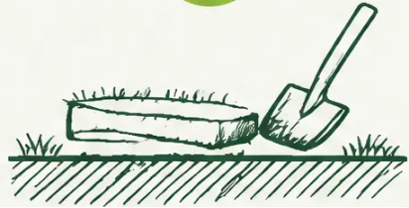
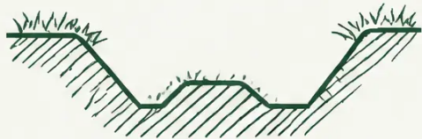


CONSTRUCTION GUIDE
PHASE 1 — STEPS 1 TO 4
Construction Steps: Phase 1
CRITICAL: Do NOT Compact the Basin Flat
A common mistake is compacting the basin entirely flat with the digger.
This prevents plant establishment and reduces biodiversity value.
Leave ridges, hollows and bumps across the basin.
01
02
03
04
Locate
Mark Out
Strip Topsoil
Excavate Basin
Find the natural low point on
impermeable soil. Confirm
inlet point and outlet direction
before any earthworks begin.
Ideally site within 10–20m of
an existing wet area or drain
to allow rapid plant colonisation.
Stake the full perimeter with
canes or spray paint. Allow an
extra 1–2m on each side for
bund material.
Remove the top 200mm of
topsoil from the full pond
footprint. Stockpile separately –
keep clean from subsoil.
Excavate to max 0.5m depth. Form
1:4 slope on inlet side (minimum).
Leave ridges, hollows and bumps
across the basin floor —
do NOT compact flat.
Create mosaic of depths for
plant colonisation.
farmingforwater.ie
Tip: Take geotagged photos at each stage –
required for EIP payment claim.

Slide 7













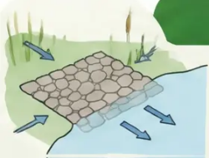


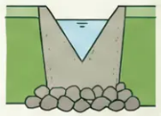
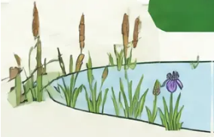

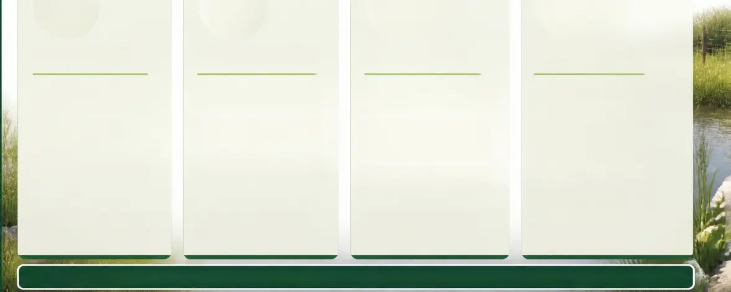

MEASURE 18
STEPS 5 – 8
Construction Steps: Phase 2
Finalise the structure, install the outlet, protect the inlet, and establish the pond margin.
CONSTRUCTION
STEP 5
STEP 6
STEP 7
STEP 8
Build the Bund
Fit the Outlet Notch
Protect the Inlet
Fence and Plant
• Use excavated subsoil –
compact in layers
• Set notch 0.1–0.2m above
pond base
• Stone apron min 0.5m × 0.5m
at inlet to prevent scour
• Stock-proof fence – 2m
buffer from water edge
• Cap with 150mm
stockpiled topsoil
• Protects outlet with stone
rip-rap armour
• Install silt trap at inlet –
min 20% of total pond area,
20–30cm deep
• Plant silt trap in blocks of
single species (not mixed)
• Target height: 0.3–0.5m
above pond base
• Options: V-notch weir, pipe
spillway, stone pitching
• Do NOT plant Common Reed –
it out-competes all other species
• Plant silt trap with: Bulrush,
Yellow Flag Iris, Water Mint
• Rest of pond: allow natural
colonisation if near existing
waterbody
On heavy clay – bund may
not be needed
Ensures permanent water
retention
Silt trap is the most critical
zone for water quality
All plants must be locally
sourced and native
Take geotagged photos from multiple angles immediately after construction. Retain contractor invoice – both required for EIP payment claim.

Slide 8






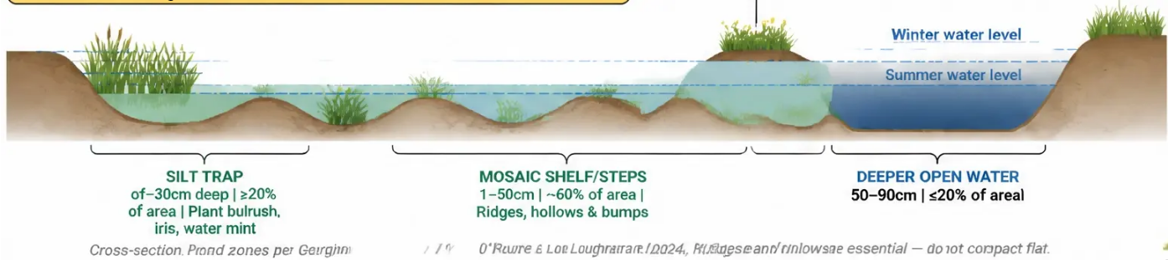





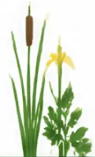











FARMING FOR WATER EIP
Pond Construction & Management
Guidelines — Georgina Mooney, UCD (2024)
COMMON MISTAKE TO AVOID
POND ZONE SUMMARY
Do NOT compact the basin flat with the digger. A flat, compacted
surface prevents plant establishment and reduces water
quality benefits. Leave ridges, hollows and bumps
throughout the basin.
Semi-permanent island
(submerged winter,
exposed summer)
Zone
Depth
Area
Location
Outlet
Silt Trap
20–30 cm
≥20%
At inlet — MUST be planted
Mosaic Shelf / Steps
1–50 cm
~60%
Throughout — ridges & bumps
Deeper Open Water
50–90 cm
≤20%
Throughout — limited
CONSTRUCTION RULES
Silt trap at inlet — min 20% of total pond area
Natural wavy boundary — not circular
Max inlet-to-outlet distance
Inlet bank slope — 1:4 gradient minimum
Ridges & hollows along edges and base — essential
Shallow areas (under 20cm) maximised
Semi-permanent islands encouraged
Pond over 1m deep requires planning permission
MANAGEMENT
PLANTING
MANAGEMENT
REST OF POND
VEGETATION
DREDGING
SILT TRAP — Must Plant (in blocks)
Remove when >70% covered.
3—5 year cycle.
Max 30% in one year.
Dredge 1/3 at a time only.
Leave overnight on bank.
Block outflow with straw bale.
Bulrush (Typha latifolia)
Allow natural colonisation if near existing waterbody
Use sediment as fertiliser off-site.
Do not remove Horsetails (Equisetum spp.) —
they aid nutrient removal
Best time: mid-autumn.
Yellow Flag Iris (Iris pseudacorus)
Water Mint (Mentha aquatica)
TREES & SHRUBS
TIMING
NO Common Reed — it out-competes
all other species
All plants must be locally sourced and native
Manage if >70% shading.
Mid-summer preferred — firm
3—5 year cycle.
ground, low water.
Avoid invasive species — may be illegal to plant
Leave dappled shade.
Avoid disturbing frogspawn (spring)
Keep kingfisher perch branches.
and hibernating frogs (autumn/winter).
STEP-BY-STEP REFERENCE
10×6×0.5m
€800
0.2 ha
NO
Typical size (L×W×D)
Per unit (up to 3)
Maximum pond area
Planning permission
needed
8 STEPS TO BUILD
BUILD BUND
Compact subsoil bank 0.3-0.5m high, cap with stockpiled topsoil.
LOCATE Natural bowl, basin, impermeable soil, along contour.
Avoid existing watercourses.
FIT OUTLET Low point in bund, reinforce with stone. 1-1.5m wide notch.
PROTECT INLET 2.5-5m wide, 1:10 slope at inflow point to prevent erosion.
MARK OUT Stake perimeter. Confirm in & outlet direction before digging.
STRIP TOPSOIL Remove top 20cm, stockpile separately for pond capping.
EXCAVATE
FENCE & PLANT Set 2m back from water edge. Plant native wetland species.
Max 0.2 ha — larger ponds lose BISS eligibility
Check proximity to SAC / SPA before construction
PAYMENT CLAIM:
Not for slurry, silage effluent or soiled water
No planning permission or discharge licence required
Geotagged photos + contractor invoice
Livestock must be excluded — fencing is mandatory
Geotagged photos + proof of costs required for payment
€800/unit | €627 with ACRES reduced rate | Max 3 units
farmingforwater.ie

Slide 9



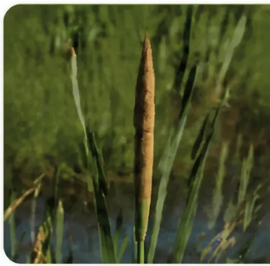

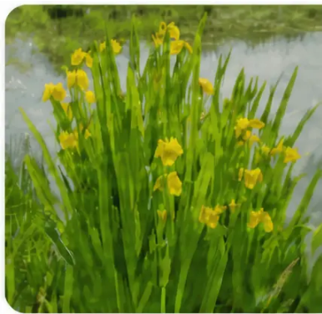



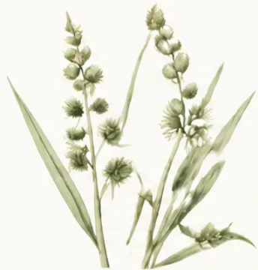




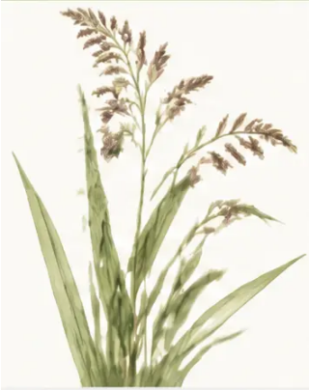


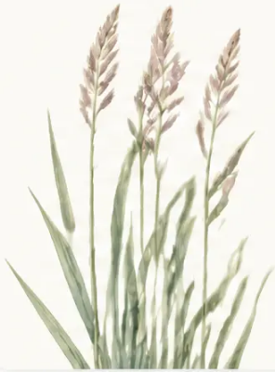
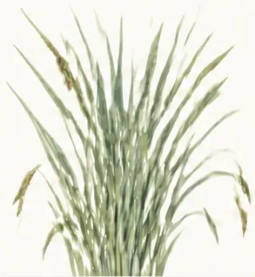

PLANTING GUIDE — TALL EMERGENT SPECIES
Plant Your Pond: Tall Species
Plant silt trap with Bulrush, Yellow Flag Iris and Water Mint — in blocks of single species, not mixed.
Do NOT use Common Reed (Phragmites australis) — it out-competes all other species and will take over the entire pond.
Tip: Horsetails (Equisetum spp.) are highly efficient for nutrient removal — do not remove them if already present on site.
Rest of pond can colonise naturally if near an existing waterbody, ditch or drain.
SILT TRAP
SILT TRAP
Branched
Bur-Reed
Bulrush
Yellow Flag Iris
Typha latifolia
Iris pseudacorus
Sparganium erectum
0.1–0.5m depth
0–0.3m depth
Dense brown sausage-
shaped spike — very
distinctive
Bright yellow flowers,
sword-shaped leaves —
late spring
0–0.3m depth
Branched stem, round
bur-like seed clusters
Plant Sept–Nov
Divide from farm
drain clumps
Plant Sept–Nov
Reed
Reed
Greater
Sweet Grass
Canary Grass
Pond Sedge
Glyceria maxima
Phalaris arundinacea
Carex riparia
0–0.4m depth
0–0.3m depth
0–0.3m depth
Broad glossy leaves, tall
architectural presence
up to 2m
Upright blue-green
leaves, pale purple-tinged
spikelets
Broad blue-green leaves,
forms large stabilising
stands
Plant Sept–Nov
Plant Sept–Nov
Plant Sept–Nov
Source: Farming for Water EIP — Measure 18
farmingforwater.ie

Slide 10




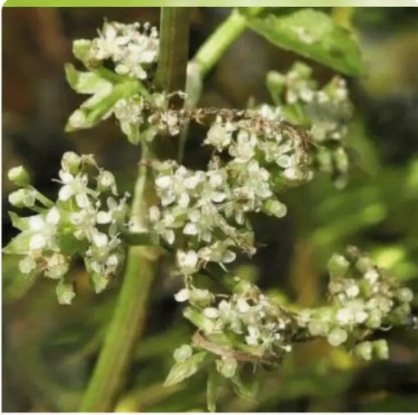
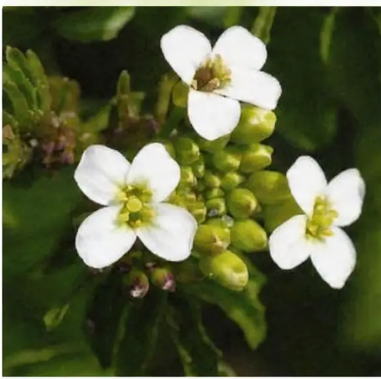
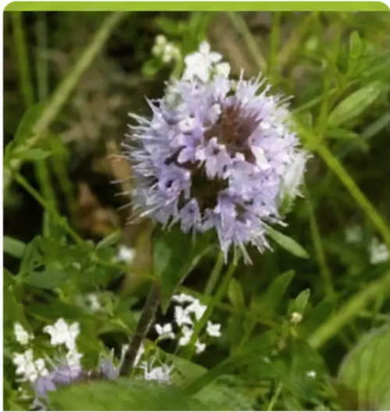
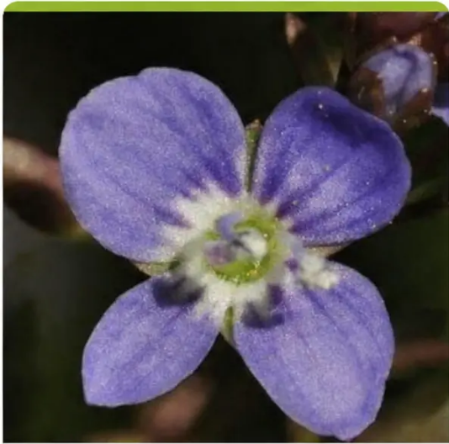
PLANTING
GUIDE
STEP 4 — ESTABLISH VEGETATION
Planting Guide: Lower Growing Species
Marginal wet zone species — 0 to 0.1m water depth — plant along shallow edges and muddy banks
MARGINAL SPECIES
Fool's Watercress
Watercress
Water Mint
Brooklime
Apium nodiflorum
Nasturtium officinale
Mentha aquatica
Veronica beccabunga
● Flowers: July – August
● Flowers: June – September
● Flowers: July – September
● Flowers: May – September
● Depth: Shallow margins, 0–0.1m
● Depth: Floating or rooting, 0–0.1m
● Height: Up to 90cm in damp margins
● Height: Low creeping to 30cm
● Role: Stabilises pond edges, roots
at nodes
● Role: Clean water indicator,
native and nutritious
● Role: Pollinator magnet —
bees and butterflies
● Role: Stabilises muddy edges,
roots in shallow water
🍃 Source from on-farm drains outside designated SAC / SPA / NHA sites — or use a specialist native Irish wetland plant supplier

Slide 11

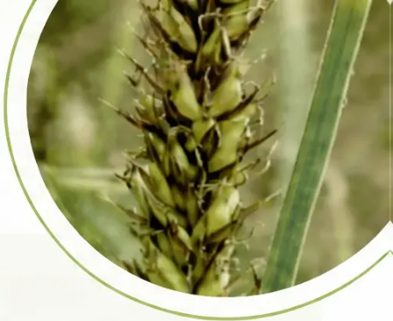
























MEASURE 18
LONG-TERM CARE
Maintenance & Monitoring
Maintenance
SCHEDULE
AVOID
HEALTHY POND ✓
2x
YEAR
Inspect Outlet & Pond
Clear debris, check water levels —
Autumn + Spring
Bank Vegetation
No livestock access —
mandatory fencing
always in place
Permanent water year-round
MID-
SUMMER
Firm ground, low water. Best time
for most management tasks.
Diverse emergent plant
fringe by Year 2
Remove Excess Vegetation
No waste connections —
no slurry, silage effluent,
soiled water
MID-
AUTUMN
Remove when >70% pond surface covered.
Max 30% removed in one year. Leave cut
material overnight on bank — invertebrates
return to water.
Frogs and newts
present by Year 2
Sediment De-silting (Silt Trap)
EVERY
3–5 YRS
Dredge silt trap on 3–5 yr cycle. Dredge
only 1/3 of pond at a time. Block outflow
with straw bale first. Use dredged
sediment as fertiliser off-site.
No chemicals in the
fenced buffer zone
Dragonflies and damselflies
by Year 1–2
EVERY
3–5 YRS
Trees & Shrubs
Manage overhanging vegetation if >70% shade.
Leave dappled light. Keep kingfisher perch
branches. Check bird nesting season.
Never complete clearance
in one operation
Wetland birds using the margins
(snipe, wagtail, heron)
Deadwood
ONGOING
Add cut branches or a log to pond — benefits
biodiversity, slows water flow, supports
microorganisms.
No game fish or
duck stocking
Clear or lightly turbid water,
no strong odour
Avoid disturbing frogspawn (spring) and
hibernating frogs (autumn/winter) when
undertaking management work.
farmingforwater.ie

Slide 12








EIP PROGRAMME
Payment & Validation
MEASURME 18
€800
€627
1-3
Per Unit — Standard EIP Rate
Per Unit — ACRES Rate
Units Per Holding
Up to 3 units per holding
When combined with Low Input
Each unit max 0.2 ha
Grassland, Extensively Grazed
MAX €2,400
Pasture, or Intensive Grassland
BISS Eligible
Next to Watercourse
What You Need to Claim
Geotagged Photos
Proof of Costs
EIP Advisor Sign-Off
Compliant Sizing
Minimum 2–3 images,
GPS location embedded
Contractor invoice or
materials receipts
On-farm verification
required
Pond must not exceed
0.2 ha — fencing in place
Farming for Water EIP — Measure 18
farmingforwater.ie

Slide 13

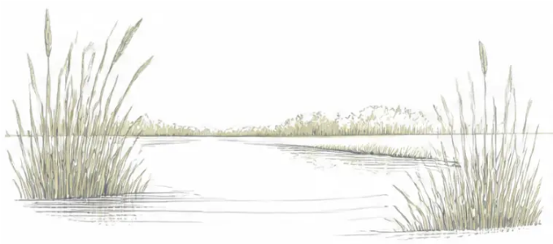











KEY RULES — AT A GLANCE
Compliance Essentials
COMPLIANCE MEASURE 18
Maximum Pond Size: 0.2 ha
Avoid Existing Ecological Areas
Larger ponds lose BISS eligibility
No hedgerows, rush pasture, wet grassland or floodplains
No Planning Permission Required
Not for Regulated Wastes
Not classified as a constructed wetland
No slurry, silage effluent, soiled water or dairy washings
No Discharge Licence Required
GAP Regulations Still Apply
Surface runoff only — no regulated effluent
S.I. No. 529 of 2020 — nutrient management obligations remain
Livestock Must Be Excluded
BISS Eligibility Maintained
Stock-proof fencing is mandatory
While pond area remains under 0.2 ha
Check Natura 2000 Proximity
Speak to Your EIP Advisor
Assess SAC, SPA and NHA sites before construction
Required sign-off before and after construction
References
• farmingforwater.ie/measures/small-scale-wetlands-pond/
Talk to Your EIP Advisor Before Construction
• Farming for Water EIP Measures Information Booklet (2025), LAWPRO & Teagasc
• S.I. No. 529 of 2020 — EU Good Agricultural Practice Regulations
• Wildflowers of Ireland: wildflowersofireland.net

